Slide 1

Predicting customer buying behaviour
18/02/2024
PPT BY- Rudra Khare

Slide 2
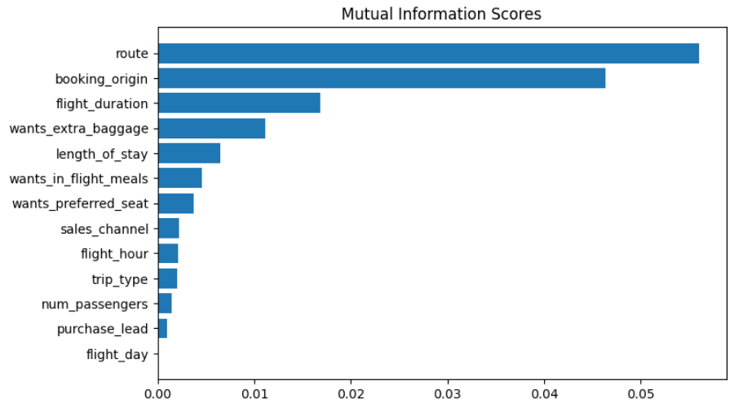
predictive model to understand factors that influence buying behaviour
We have trained the data set with Random Forest Classifier model and received
ACCURACY: 84.6
AUC score: 0.5477099
route
booking_origin
flight_duration
wants_extra_baggage
length_of_stay
num_passengers
are the top 6 features which influence
Customer buying behavior
We need to increase the AUC score.

